Slide 1
Software Management Renaissance
Mekonnen Wagaw (PhD)

Slide 2
Outline
Conventional Software Management
Evolution of Software Economics
Improving Software Economics
The old way, and the new way

Slide 3
The Old Way
Conventional Software Management
Software crisis
“The best thing about software is its flexibility”
It can be programmed to do almost anything.
“The worst thing about software is also its flexibility”
The “almost anything” characteristic has made it difficult to plan, monitor, and control software development.

Slide 4
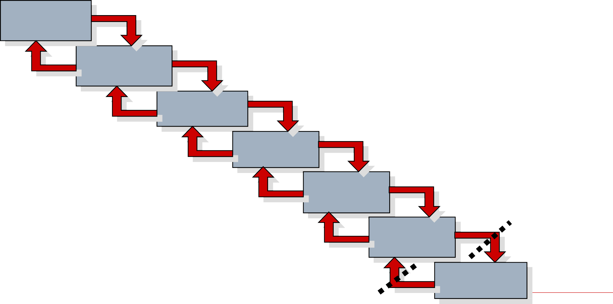
The Old Way
The Waterfall Model
System requirements
Software
requirements
Analysis
Drawbacks
Protracted integration & late design breakage
Program design
Late risk resolution
Requirements - driven functional decomposition
Adversarial stakeholder relationships
Focus on document and review meetings
Coding
Testing
Maintenance
and reliance

Slide 5
The Old Way
Conventional Software Management Performance
1) Finding and fixing a software problem after delivery costs 100 times more than finding and fixing the problem in early design phases.
2) You can compress software development schedules 25% of nominal, but no more.
3) For every $1 you spend on development, you will spend $2 on maintenance.
4) Software development and maintenance costs are primarily a function of the number of source lines of code.

Slide 6
The Old Way
Conventional Software Management Performance
5) Variations among people account for the biggest differences in software productivity.
6) The overall ratio of software to hardware costs is still growing.
In 1955 it was 15:85; in 1985, 85:15.
7) Only about 15% of software development effort is devoted to programming.
8) Walkthroughs catch 60% of the errors.
9) 80% of the contribution comes from 20% of contributors.

Slide 7
Software Economics
Software economics is the study of how scarce project resources are allocated for software projects.
Software economics helps software managers allocate those resources in the most efficient manner.

Slide 8
Evolution of Software Economics
Most software cost models can be abstracted into a function of five basic parameters:
Size (typically, number of source instructions)
Process (the ability of the process to avoid non-value- adding activities)
Personnel (their experience with software development issues and the applications domain issues of the project)
Environment (tools and techniques available to support efficient software development and to automate process)
Quality (performance, reliability, adaptability…)

Slide 9
Three generations of software economics
Cost
Software size
1960s-1970s
Waterfall model Functional design Diseconomy of scale
1980s-1990s
Process improvement Encapsulation-based Diseconomy of scale
2000 and on Iterative development Component- based Return to investment
Environments/tools: Custom
Size: 100% custom
Process: Ad hoc
Environments/tools: Off-the-shelf, separate
Size: 0%component-based, 70% custom
Process: Repeatable
Environments/tools: Off-the-shelf, integrated
Size: 0%component-based, 30% custom
Process: Managed/measured
3
7
Typical project performance
Predictably bad
Always:
-Over budget
-Over schedule
Unpredictable
Infrequently:
-On budget
-On schedule
Predictable
Usually:
-On budget
-On schedule

Slide 10
The predominant cost estimation process
Software manager, software architecture manager, software development manager, software assessment manager
Cost modelers
Risks, options, trade-offs, alternatives
Cost estimate

Slide 11
Pragmatic software cost estimation
A good estimate has the following attributes:
It is conceived and supported by the project manager, architecture team, development team, and test team accountable for performing the work.
It is accepted by all stakeholders as ambitious but realizable.
It is based on a well defined software cost model with a credible basis.
It is based on a database of relevant project experience that includes similar processes, technologies, environments, quality requirements, and people.
It is defined in enough detail so that its key risk areas are understood and the probability of success is objectively assessed.

Slide 12
Improving Software Economics
Five basic parameters of the software cost model:
Reducing the size or complexity of what needs to be developed
Improving the development process
Using more-skilled personnel and better teams (not necessarily the same thing)
Using better environments (tools to automate the process)
Trading off or backing off on quality thresholds

Slide 13

Important Trends in Improving Software Economics
Cost model parameters Trends
Higher order languages
(C++, Java, Visual Basic, etc.)
Object-oriented
(Analysis, design, programming)
Reuse Commercial components
Iterative development Process maturity models
Architecture-first development Acquisition reform
Size
Abstraction and component based development technologies
Process
Methods and techniques
Personnel
People factors
Training and personnel skill development Teamwork
Win-win cultures
Integrated tools
(Visual modeling, compiler, editor, etc)
Open systems Hardware platform performance
Automation of coding, documents, testing, analyses
Environment
Automation technologies and tools
Quality
Performance, reliability, accuracy
Hardware platform performance Demonstration-based assessment Statistical quality control

Slide 14
Reducing Software Product Size
“The most significant way to improve affordability and return on investment is usually to produce a product that achieves the design goals with the minimum amount of human-generated source material.”
Reuse, object-oriented technology, automatic code production, and higher order programming languages are all focused on achieving a given system with fewer lines of human-specified source directives.

Slide 15
Reducing Software Product Size - Languages
Language | SLOC per UFP
Assembly | 320
C | 128
Fortran 77 | 105
Cobol 85 | 91
Ada 83 | 71
C++ | 56
Ada 95 | 55
Java | 55
Visual Basic | 35
UFP -Universal Function Points The basic units of the function points are external user inputs,
external outputs,
internal logic data groups, external data interfaces, and external inquiries.
SLOC metrics
are useful estimators for software
after a candidate solution is formulated and
an implementation language is known.

Slide 16
Reducing Software Product Size – Object-Oriented Methods
An object-oriented model of the problem and its solution encourages a common vocabulary between the end users of a system and its developers, thus creating a shared understanding of the problem being solved.
The use of continuous integration creates opportunities to recognize risk early and make incremental corrections without destabilizing the entire development effort.
An object-oriented architecture provides a clear separation of concerns among disparate elements of a system, creating firewalls that prevent a change in one part of the system from rending the fabric of the entire architecture.

Slide 17
Reducing Software Product Size – Reuse
1 Project Solution:
$N and M months
Many-project solution: Operating with high value per unit investment, typical of commercial products
Development Cost
and Schedule Resources
2 Project Solution: 50% more cost and
100% more time
5 Project Solution: 125% more cost and
150% more time
Number of Projects Using Reusable Components

Slide 18



Reducing Software Product Size – Commercial Components
APPROACH | ADVANTAGES | DISADVANTAGES
Commercial components | Predictable license costs Broadly used, mature technology Available now Dedicated support organization Hardware/software independence Rich in functionality | Frequent upgrades Up-front license fees Recurring maintenance fees Dependency on vendor Run-time efficiency sacrifices Functionality constraints Integration not always trivial No control over upgrades and maintenance Unnecessary features that consume extra resources Often inadequate reliability and stability Multiple-vendor incompatibility
Custom development | Complete change freedom Smaller, often simpler implementations Often better performance Control of development and enhancement | Expensive, unpredictable development Unpredictable availability date Undefined maintenance model Often immature and fragile Single-platform dependency Drain on expert resources

Slide 19
Three levels of processes and their attributes
Attributes | Metaprocess | Macroprocess | Microprocess
Subject | Line of business | Project | Iteration
Objectives | Line-of-business profitability Competitiveness | Project profitability Risk management Project budget, schedule, quality | Resource management Risk resolution Milestone budget, schedule, quality
Audience | Acquisition authorities, customers Organizational management | Software project managers Software engineers | Subproject managers Software engineers
Metrics | Project predictability Revenue, market share | On budget, on schedule Major milestone success Project scrap and rework | On budget, on schedule Major milestone progress Release/iteration scrap and rework
Concerns | Bureaucracy vs. standardization | Quality vs. financial performance | Content vs. schedule
Time scales | 6 to 12 months | 1 to many years | 1 to 6 months

Slide 20
Improving Team Effectiveness (1)
The principle of top talent: Use better and fewer people.
The principle of job matching: Fit the task to the skills and motivation of the people available.
The principle of career progression: An organization does best in the long
run by helping its people to self-actualize.
The principle of team balance: Select people who will complement and harmonize with one another.
The principle of phase-out: Keeping a misfit on the team doesn’t benefit
anyone.

Slide 21
Improving Team Effectiveness (2)
Important Project Manager Skills on improving team effectiveness:
Hiring skills. Few decisions are as important as hiring decisions. Placing the right person in the right job seems obvious but is surprisingly hard to achieve.
Customer-interface skill. Avoiding adversarial relationships among stake-
holders is a prerequisite for success.
Decision-making skill. The Jillion books written about management have failed to provide a clear definition of this attribute. We all know a good leader when we run into one, and decision-making skill seems obvious despite its intangible definition.
Team-building skill. Teamwork requires that a manager establish trust, motivate progress, exploit eccentric prima donnas, transition average people into top performers, eliminate misfits, and consolidate diverse opinions into a team direction.
Selling skill. Successful project managers must sell all stakeholders (including themselves) on decisions and priorities, sell candidates on job positions, sell changes to the status quo in the face of resistance, and sell achievements against objectives. In practice, selling requires continuous negotiation,
compromise, and empathy.

Slide 22
Achieving Required Quality
Key practices that improve overall software quality:
Focusing on driving requirements and critical use cases early in the life cycle, focusing on requirements completeness and traceability late in the life cycle, and focusing throughout the life cycle on a balance between requirements evolution, design evolution, and plan evolution
Using metrics and indicators to measure the progress and quality of an architecture as it evolves from a high- level prototype into a fully compliant product

Slide 23
Achieving Required Quality
Key practices that improve overall software quality:
Providing integrated life-cycle environments that support early and continuous configuration control, change management, rigorous design methods, document automation, and regression test automation
Using visual modeling and higher level language that support architectural control, abstraction, reliable programming, reuse, and self-documentation
Early and continuous insight into performance issues through demonstration-based evaluations

Slide 24


The Old Way and the New

Slide 25
The Principles of Conventional Software Engineering
Make quality #1.
High-quality software is possible.
Give products to customers early.
Determine the problem before writing the requirements.
Evaluate design alternatives.
Use an appropriate process model.
Use different languages for different phases.
Minimize intellectual distance.
Put techniques before tools.
Get it right before you make it faster.

Slide 26
The Principles of Conventional Software Engineering
Inspect code.
Good management is more important than good technology.
People are the key to success.
Follow with care.
Take responsibility.
Understand the customer’s priorities.
The more they see, the more they need.
Plan to throw one away .
Design for change.
Design without documentation is not design.

Slide 27
The Principles of Conventional Software Engineering
Use tools, but be realistic.
Avoid tricks.
Encapsulate.
Use coupling and cohesion.
Use the McCabe complexity measure.
Don’t test your own software.
Analyze causes for errors.
Realize that software’s entropy increases.
People and time are not interchangeable.
Expert excellence.

Slide 28
The Principles of Modern Software Management
Architecture-first approach
The central design element
Design and integration first, then production and test
Iterative life-cycle process
The risk management element
Risk control through ever-increasing function, performance, quality
Component-based development
The technology element
Object-oriented methods, rigorous notations, visual modeling
Change management environment
The control element
Metrics, trends, process instrumentation
Round-trip engineering
The automation element
Complementary tools, integrated environments

Slide 29
Modern Project Profiles
Top 10 Software Management Principles
Base the process on an architecture-first approach – rework rates remain stable over the project life cycle.
Establish an iterative life-cycle process that confronts
risk early
Transition design methods to emphasize component-based development
Establish a change management environment – the dynamics
of iterative development, including concurrent workflows by
different teams working on shared artifacts, necessitate highly
controlled baselines
Enhance change freedom through tools that support
round-trip engineering

Slide 30
Modern Project Profiles
Top 10 Software Management Principles
Capture design artifacts in rigorous, model-based notation
Instrument the process for objective quality control and progress assessment
Use a demonstration-based approach to asses intermediate artifacts
Plan intermediate releases in groups of usage scenarios with
evolving levels of detail
Establish a configurable process that is economically
scalable

Slide 31
Modern Project Profiles
Software Management Best Practices
There is nine best practices:
Formal risk management
Agreement on interfaces
Formal inspections
Metric-based scheduling and management
Binary quality gates at the inch-pebble level
Program-wide visibility of progress versus plan
Defect tracking against quality targets
Configuration management
People-aware management accountability

Slide 32
Next-Generation Software Economics
Next-Generation Cost Models
Software experts hold widely varying opinions about software economics and its manifestation in software cost estimation models:
source lines of code function points
productivity measures
quality measures
C++
functionally oriented
VERSUS
Java
object-oriented
It will be difficult to improve empirical estimation models while the project data going into these models are noisy
and highly uncorrelated, and are based on differing process
and technology foundations.

Slide 33
Next-Generation Software Economics
Next-Generation Cost Models
Some of today’s popular software cost models are not well matched to an
iterative software process focused an architecture-first approach
Many cost estimators are still using a conventional process experience base
to estimate a modern project profile
A next-generation software cost model should explicitly separate architectural engineering from application production, just as an architecture-first process does.
Two major improvements in next-generation software cost estimation models:
Separation of the engineering stage from the production stage will force estimators to differentiate between architectural scale and implementation size.
Rigorous design notations such as UML will offer an opportunity to define units of measure for scale that are more standardized and therefore can be automated and
tracked.

Slide 34
Thank you

